Slide 1
Cleanipedia
Solutions Provided : Social Analytics Dashboard, Recommendation Engine and E-commerce Links aggregator
Team Brogrammers
IIIT Bangalore

Slide 2

Problem Statement
What is best for me?

Slide 3
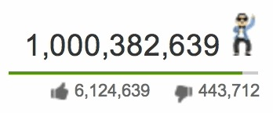


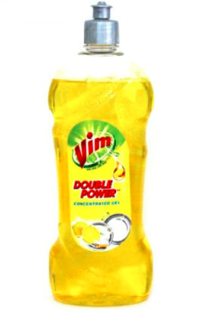

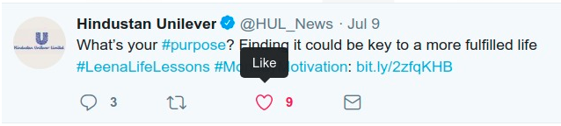
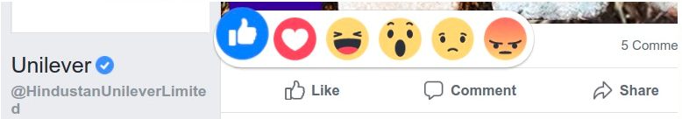

Lots of data getting generated !

Slide 4
How to convince Bob that he is buying the best?
Give him more insights into the product. But how?
Try to engage him by generating personalized Recommendations !
GOALS :
Increasing customer session duration
Targeted Product Marketing
Building user base for Cleanipedia.

Slide 5
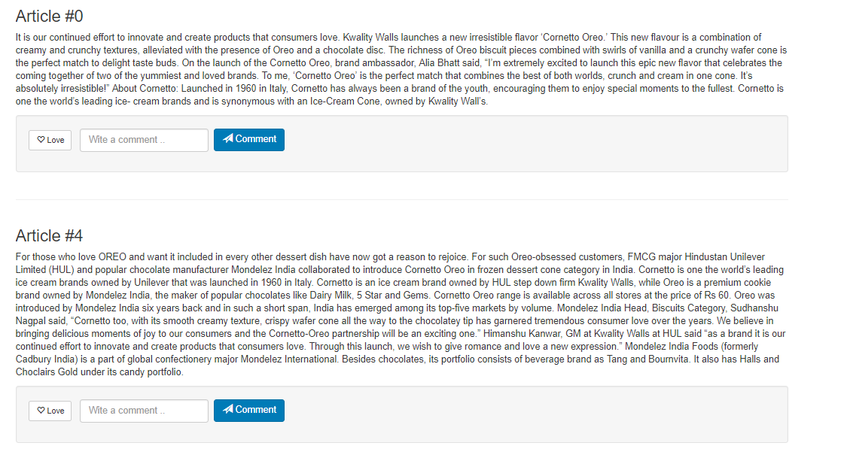
Module 1: Consumer Engagement
Recommendations based on what?
Based on what user reads (content of the article)
Based on what others read with similar reading habits
Based on user’s personal and demographic data

Slide 6


Architecture of Recommendation System
User Identifier
FLASK REST SERVER HOSTED ON CLOUD
Articles
LDA Model
Spectral Clustering
User Profiles
Rules
Reading Habits
TF-IDF with NER Model
K-prototypes Clustering
Pickled Models

Slide 7

Bob is now convinced !
Can we help him to buy the product?
Data Aggregator seems to be an ideal choice.
Module 2: Integration with Ecommerce Link

Slide 8
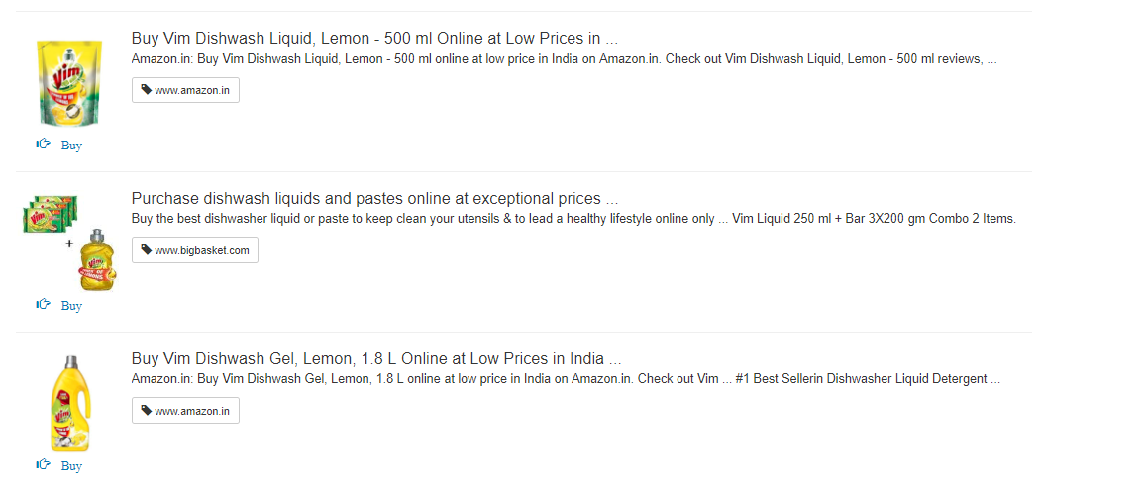
Google Custom Search Engine
Custom Search API
REST Server
User Interface

Slide 9

Rob : A data analyst at Cleanipedia
What he wants ?
To capture all such journeys like that of Bob.
To improve Success Rate of several product campaigns
Analysing the GBs of data coming from Social Media
Pain Points ?
Each platform has it’s own analytics dashboard.
Determining where and how much to spend on social platforms?
Aggregating data and summarising it.
Summarising customer response across platforms.
Calculating KPIs.

Slide 10
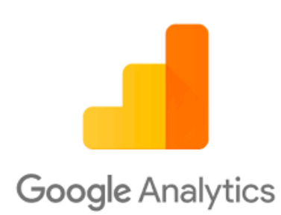
Module 3 : Integrated Performance Dashboard
Aggregated Data Visualisations

Slide 11
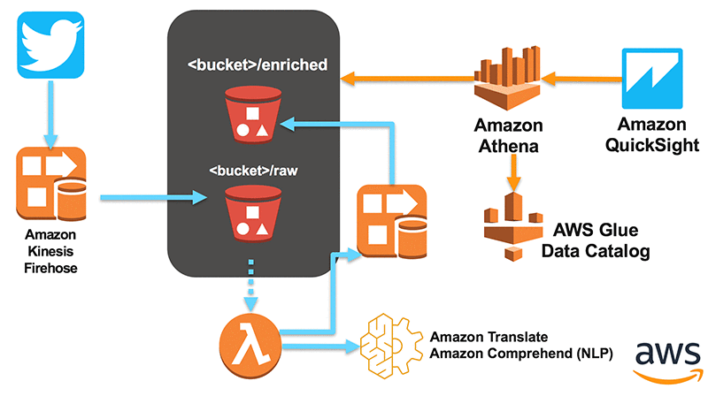
Architecture
Data Source

Slide 12
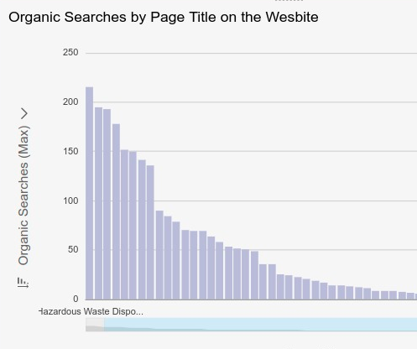
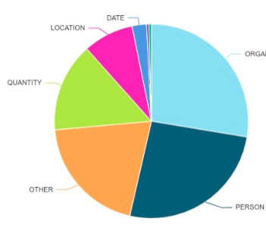
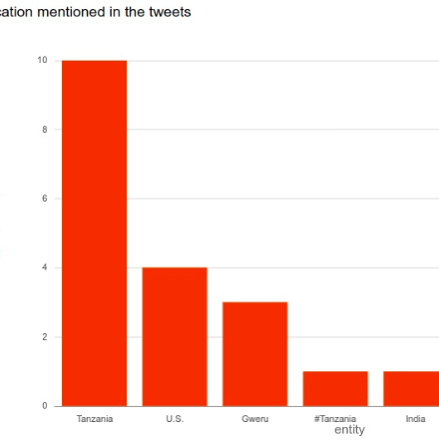
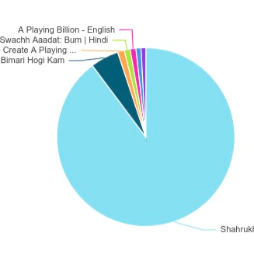
Data Visualisations that matter !
Better insights into data.
Consolidated performances of campaigns across dashboards.
Sentiment Analysis
Userbase evaluation

Slide 13
Thank You !

